Slide 1
Disorder-induced Temporal Topology in a Chiral Photonic Time Crystal
He Kunze
2026.8.6

Slide 2
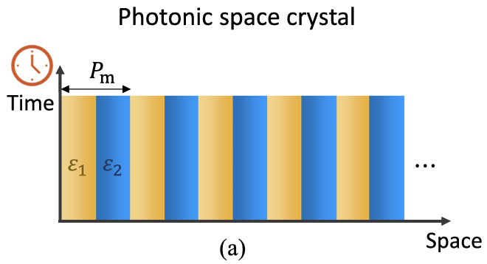
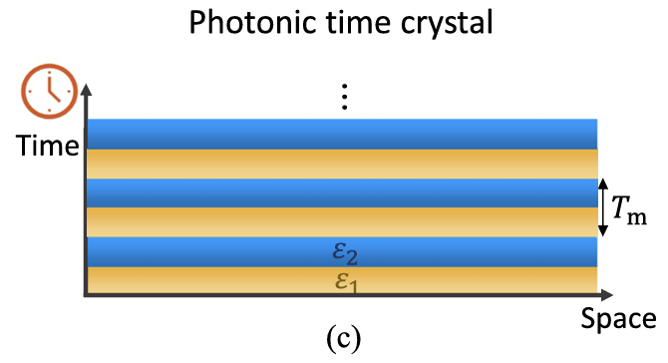
Background: Photonic Time Crystals (PTCs)

